Slide 1
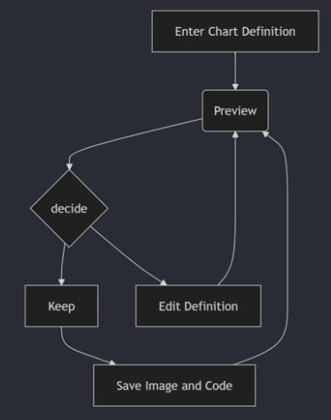
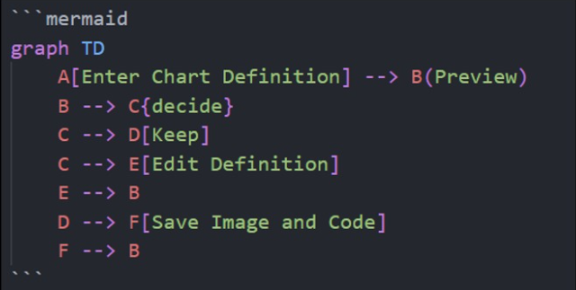

Process Maps As Code
With mermaid
Richard Jackson | @jacksorjacksor
Umbraco Kent Meetup | 14th November 2024

Slide 2

ABOUT ME: Richard Jackson
Cloud Software Engineer at Nightingale HQ
Cardiff-based
Umbraco MVP
Dev by day, musician by night, tired all the time

Slide 3
CONTENTS
The meme that haunts
Process maps are useful
Process Maps As Code (“Hey that’s the name of the talk”)
What does Mermaid do?
Where can Mermaid do the things that Mermaid does?
The AI section *drinks*
Reflections
Q&A

Slide 4
1. The Meme that haunts

Slide 5
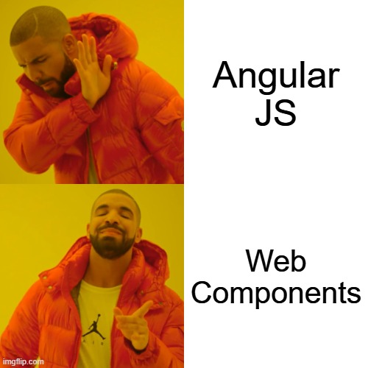


Combination of text and images
Clearly understandable
High level concepts
Low effort
Easily distributed
Common associations/Cultural Shorthands

Slide 6
…

Slide 7
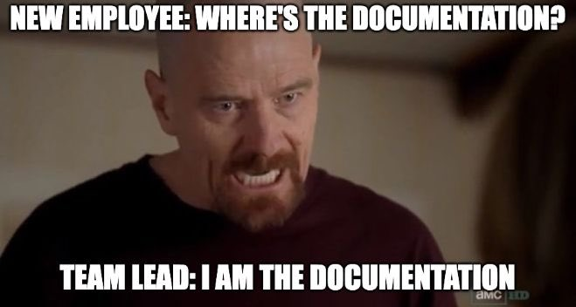

Slide 8
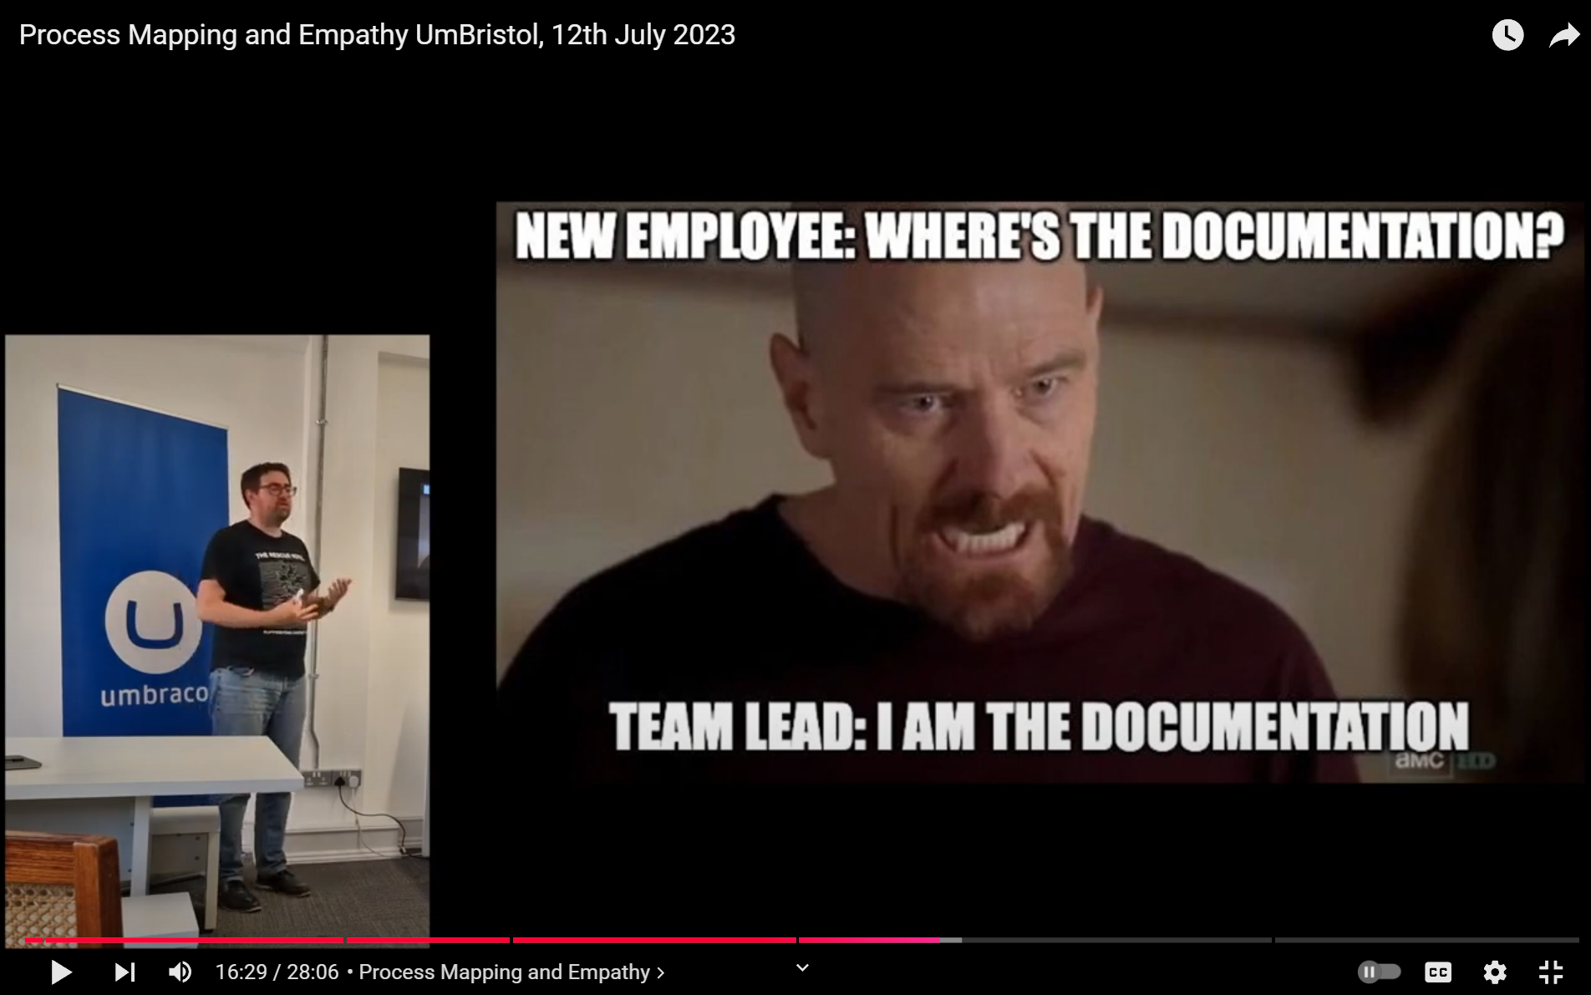
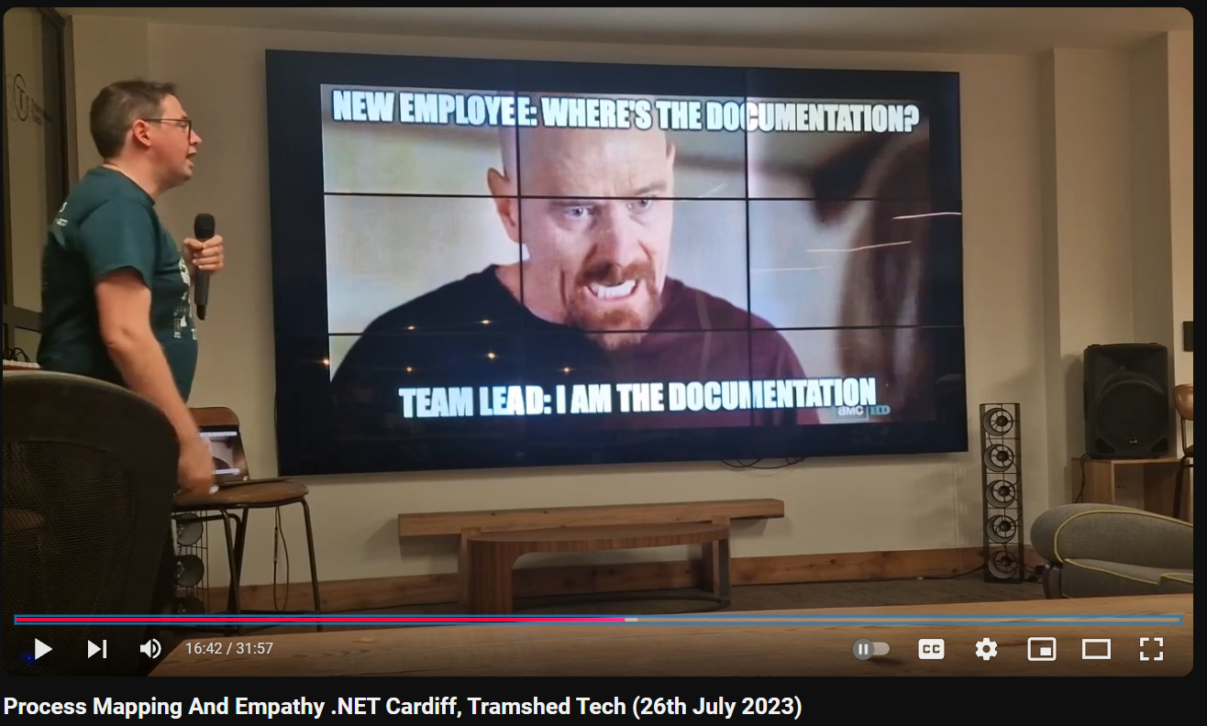
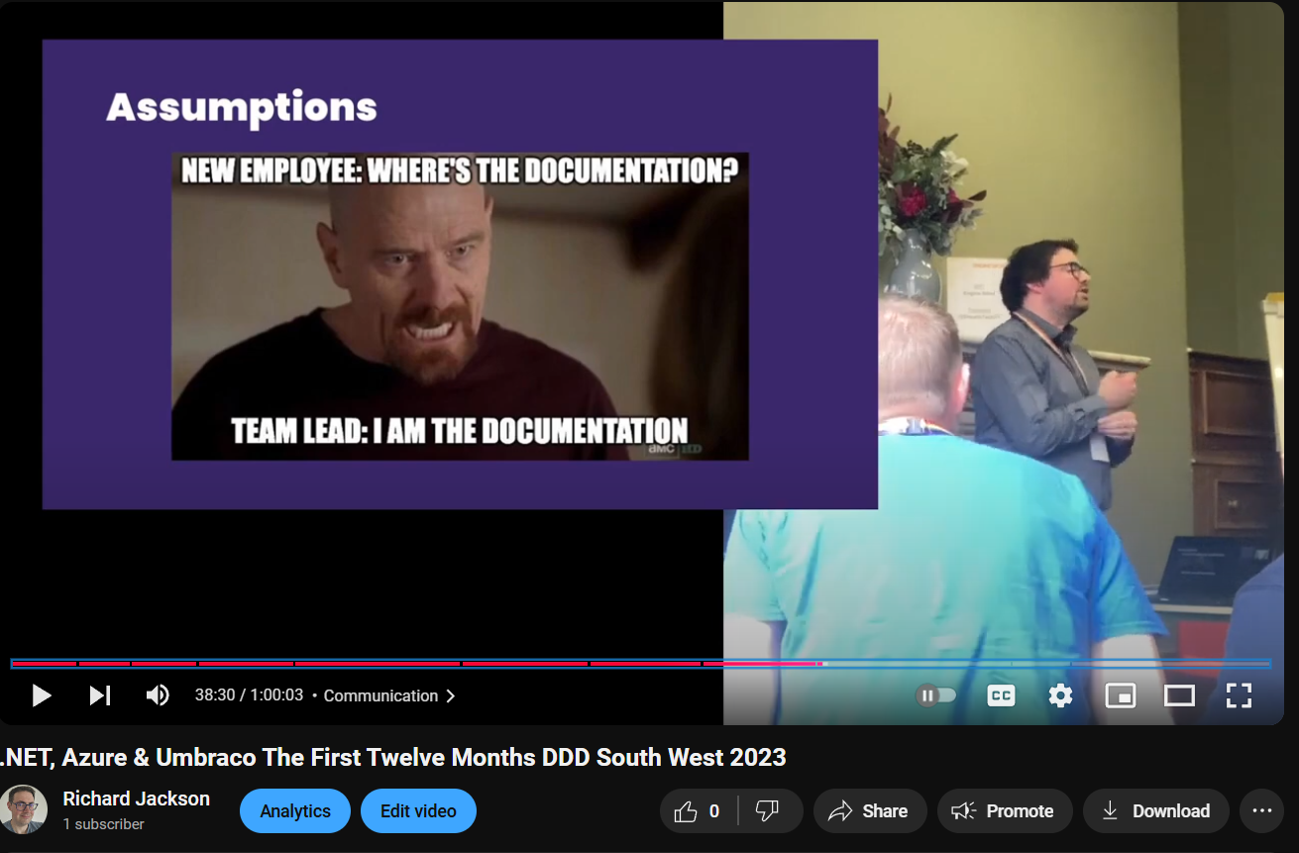
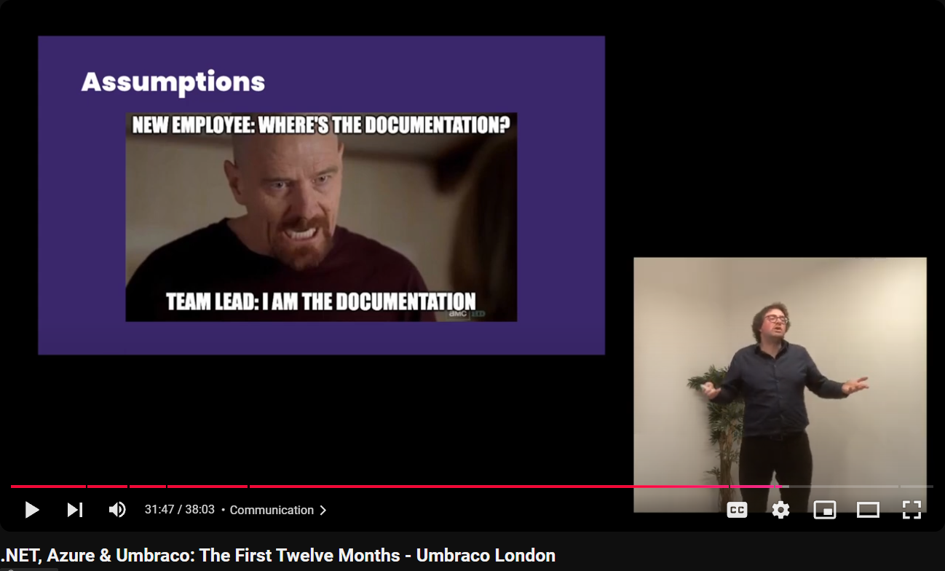

Slide 9
What this meme says to me
Difficulties with onboarding
Lack of high-level process overviews
Necessity to rely on manager as educator / point of knowledge
Literal, actual fear of awkward social situations

Slide 10
2. Process Maps are useful

Slide 11
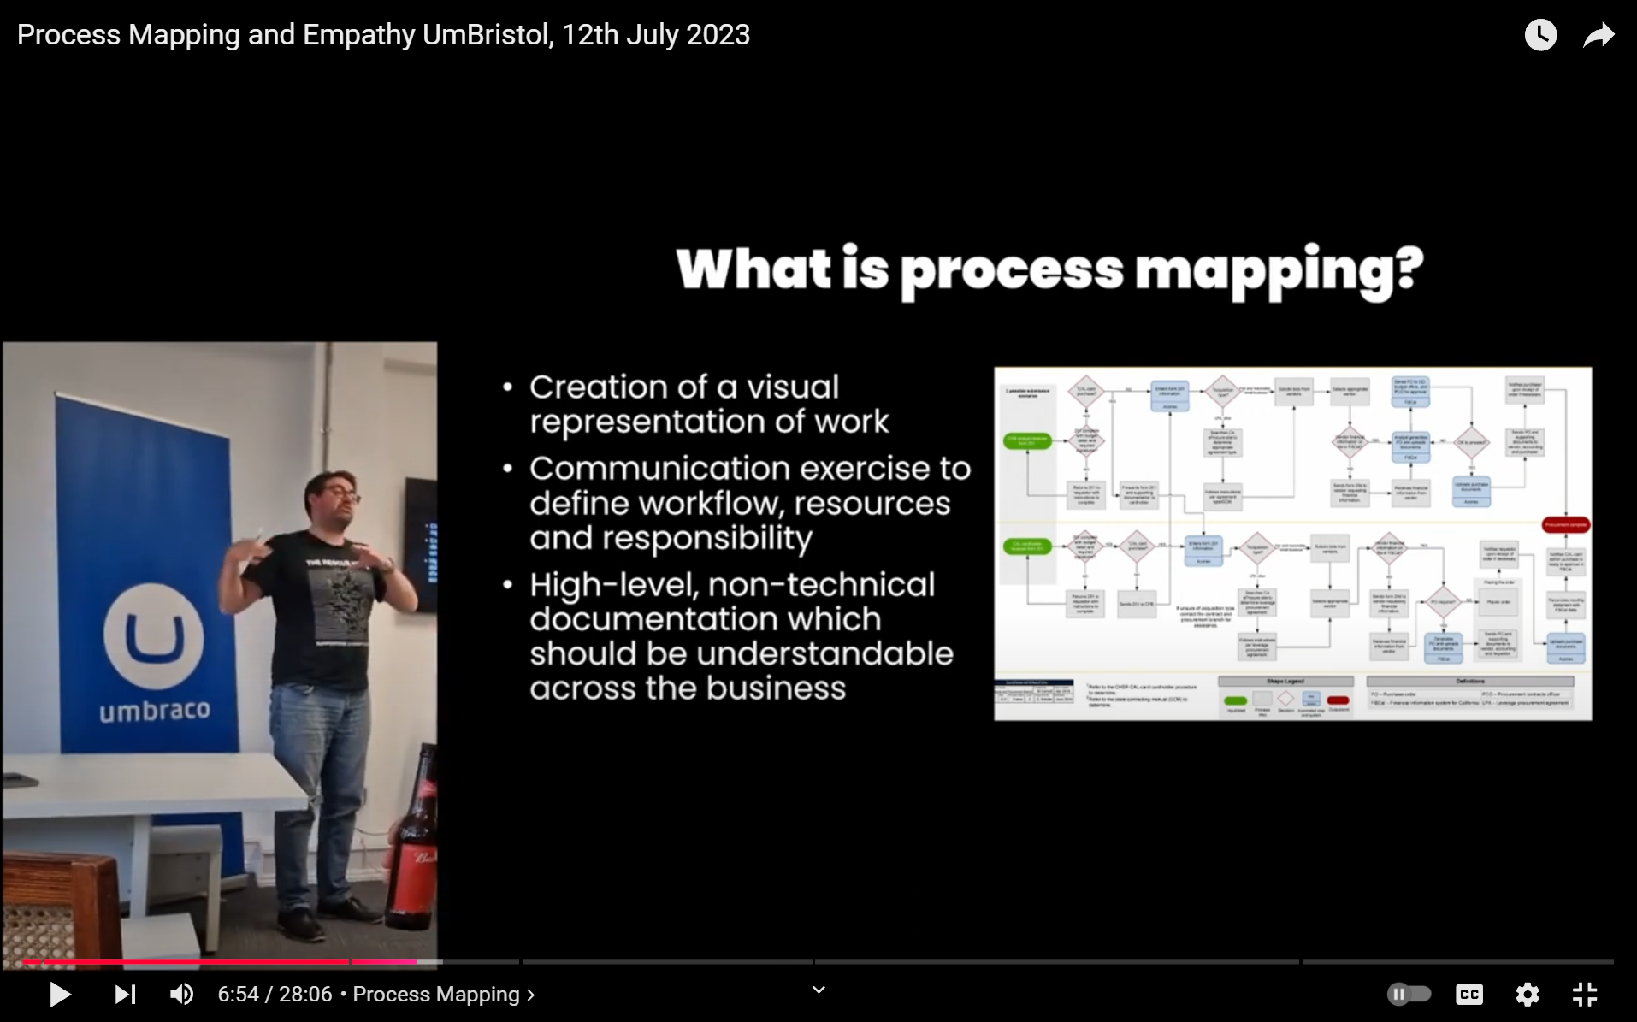

Slide 12
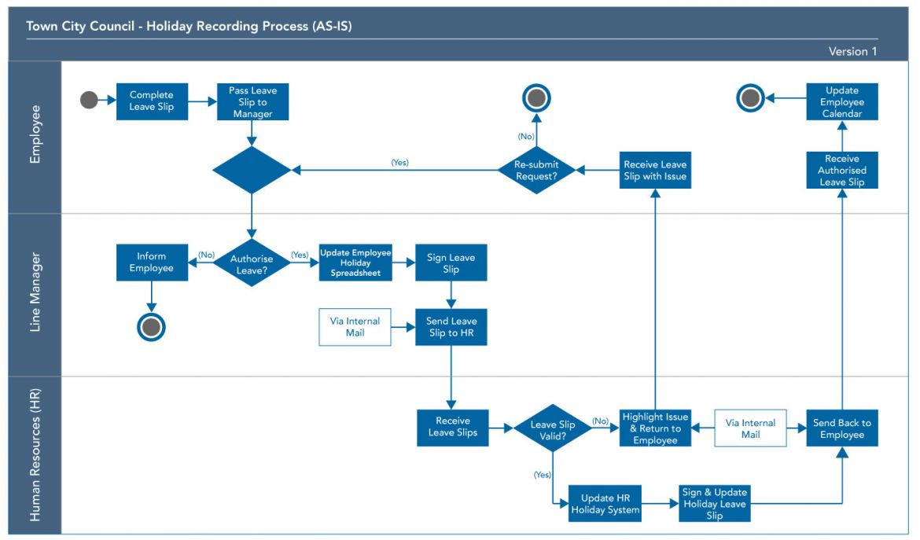
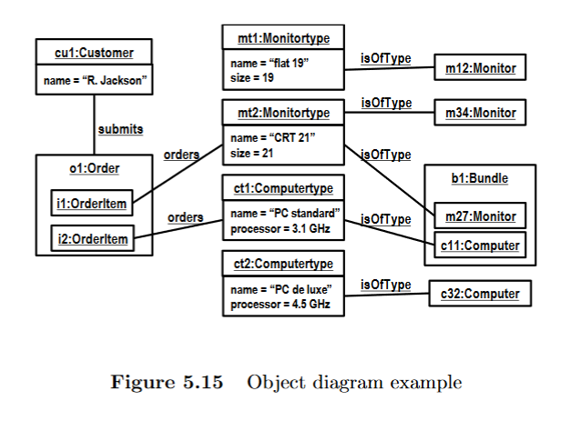
Different levels of process visualisation
Process Mapping
Process MODELLING
High-level
Subjective
Low-level
Objective

Slide 14

Benefits of process mapping
Provides single source of truth for discussion, iteration and improvement
Challenges assumptions
Reduces tacit knowledge
Improve onboarding of new staff
Creates empathy between departments

Slide 15



Graphics Packages for Process Mapping
Diagrams.net
(formally Draw.io)
Lucidchart
Microsoft Visio

Slide 16
Key problems with making & maintaining process maps
Requires upskilling on graphics package
Separate file to the work
Developers not necessarily comfortable with aesthetic design
Takes time to create
Needs to be easily maintainable

Slide 17
3. Process Maps As Code (hey it’s the name of the talk)

Slide 18
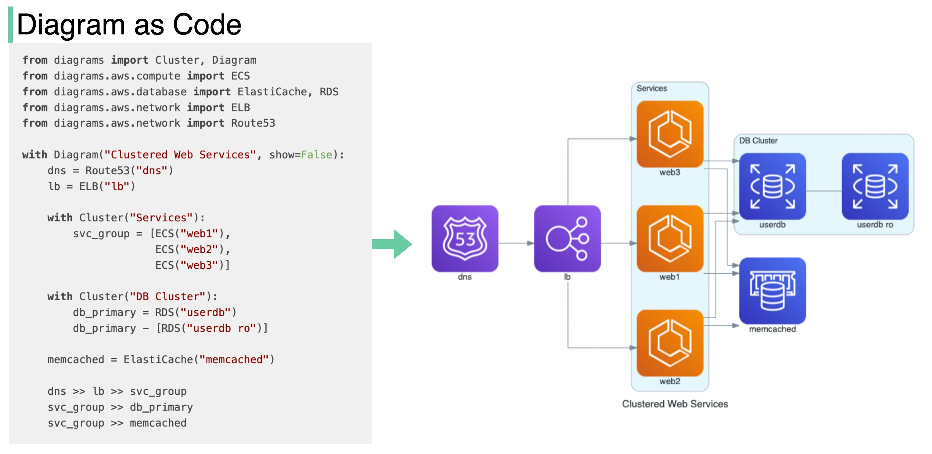
PROCESS MAPs AS CODE
Source: Diagram as Code - by Alex Xu - ByteByteGo Newsletter

Slide 19

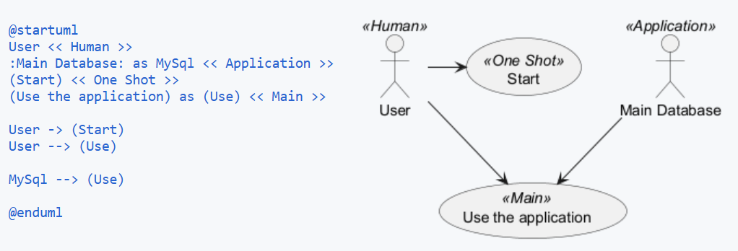
PlantUML

Slide 20

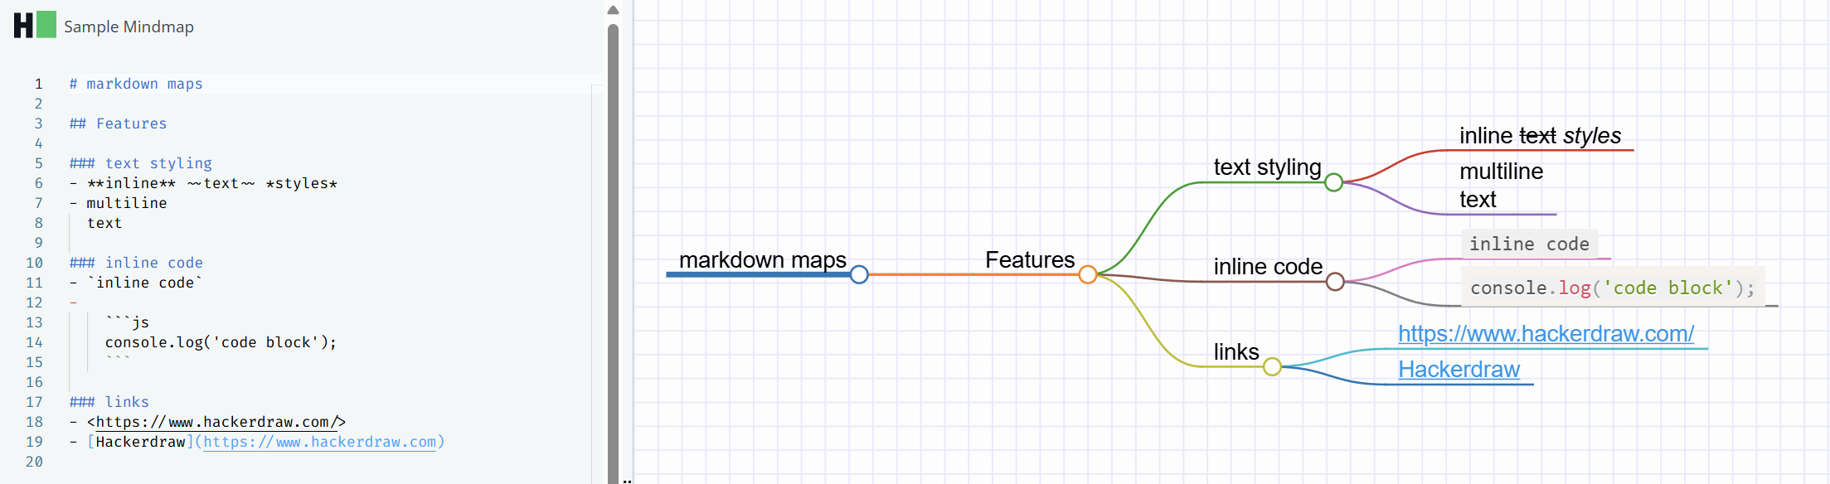
HackerDraw

Slide 21
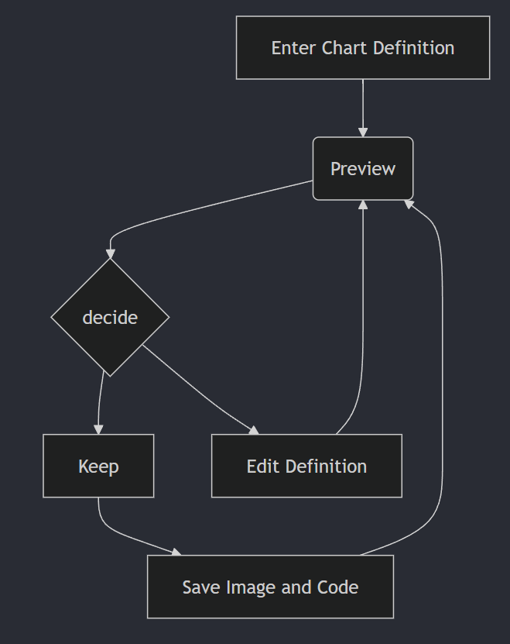
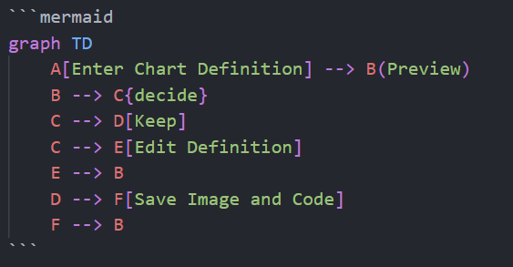
Mermaid

Slide 22
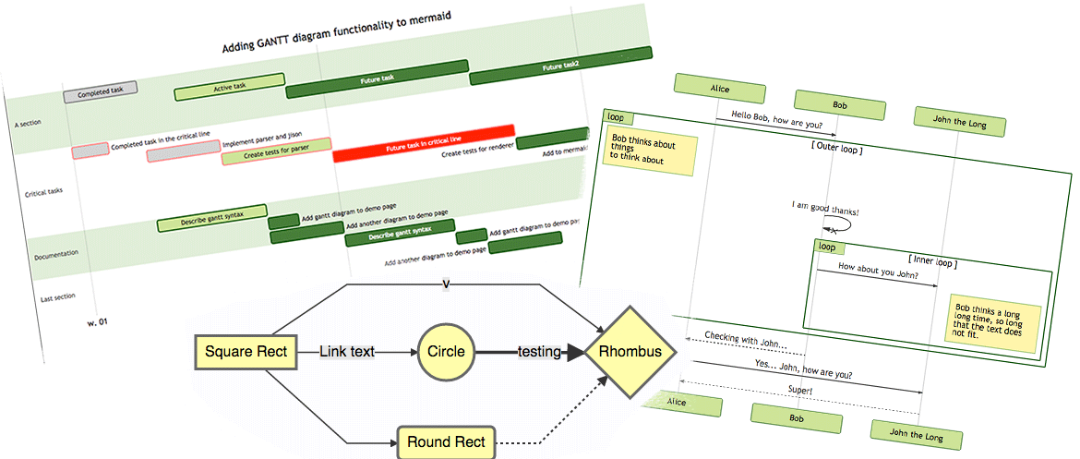
About Mermaid
JavaScript-based diagramming and charting tool
Won the JS Open Source Awards (2019) category "The most exciting use of technology"!!!
Goal: “help documentation catch up with development”

Slide 23
4. “What does Mermaid do?”

Slide 24
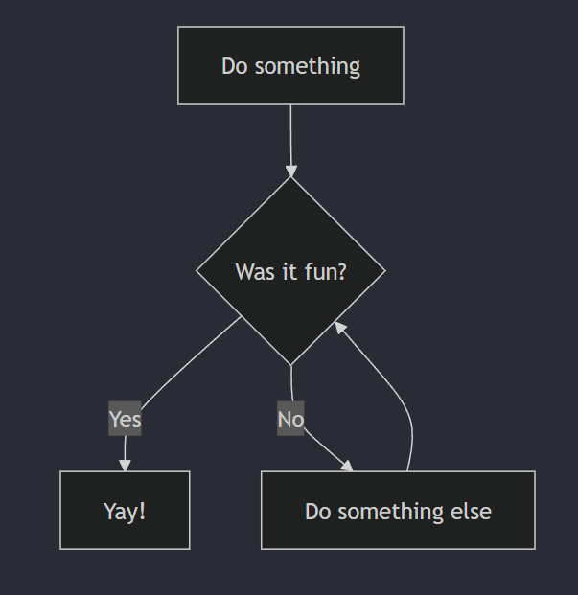
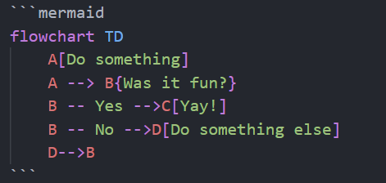
Example: Flowchart

Slide 25
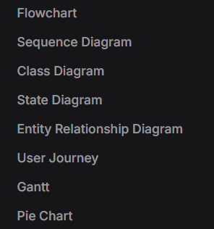
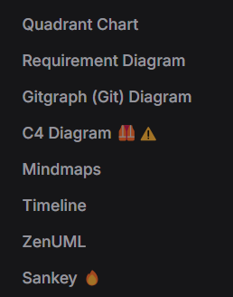
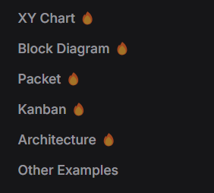
Diagram Types
(added Oct 30th)

Slide 26
Example: Flowchart

Slide 27
Syntax
Language specifier
Metadata
Chart type
Shape text
Variable initialiser
Arrow type
Shape definition

Slide 28
Metadata
Language specifier
Chart
type
Shape text
Variable initialiser
Arrow type
Shape definition

Slide 29
Example: Flowchart
Metadata

Slide 30
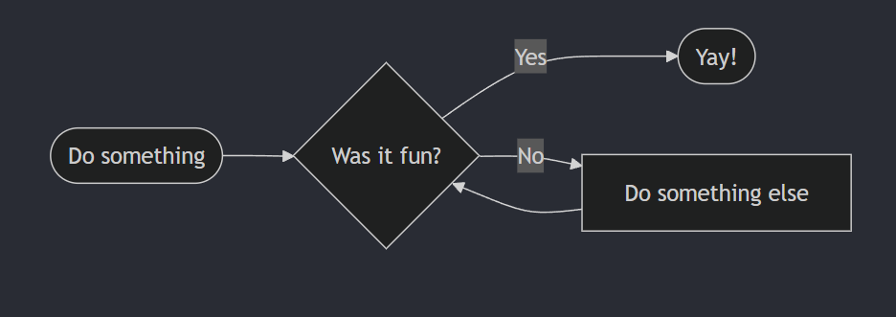
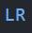
Example: Flowchart
Metadata

Slide 31
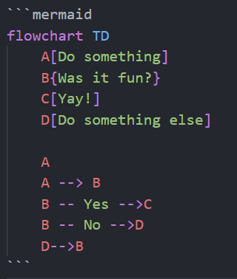
Separate Assignation to Usage

Slide 32
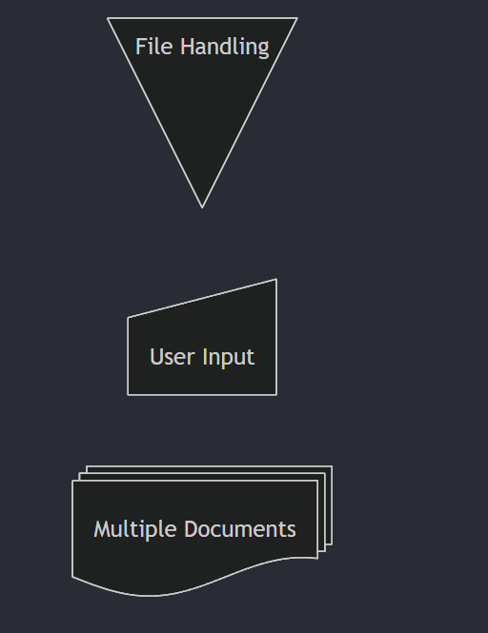
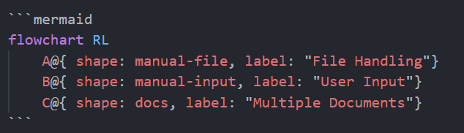
Defining Shapes
Flowcharts Syntax | Mermaid

Slide 33
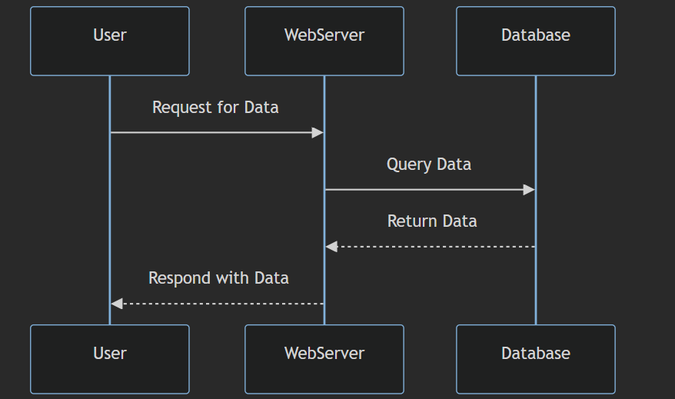
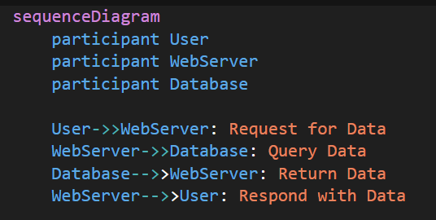
Sequence Diagram

Slide 34
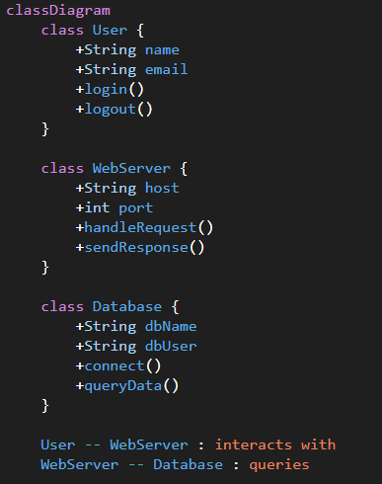
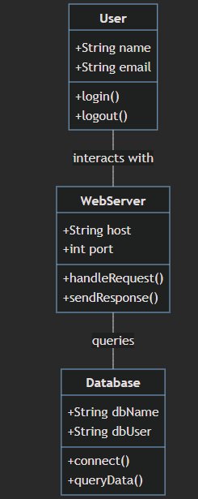
UML Class Diagram

Slide 35
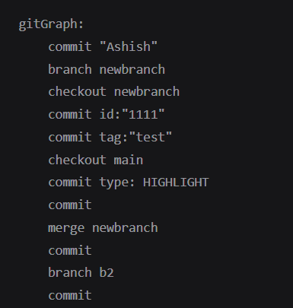
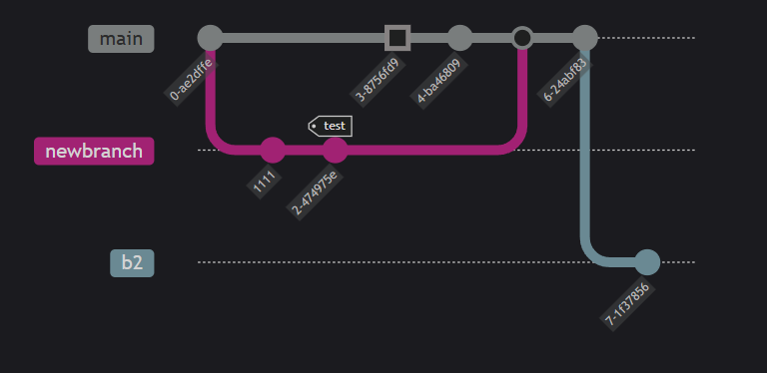
Gitgraph

Slide 36
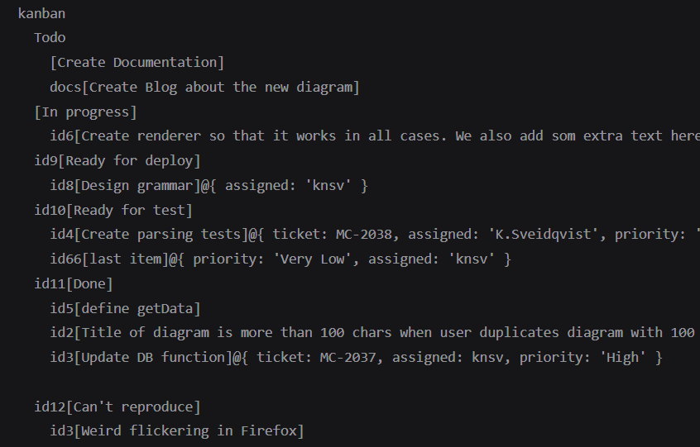
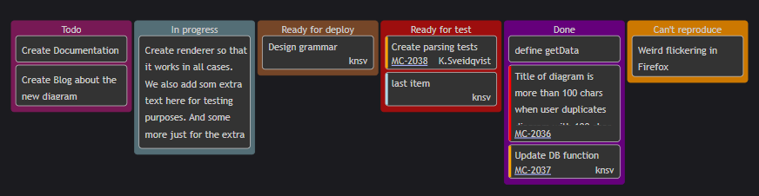
KanbaN

Slide 37
Diagram Types
(added Oct 30th)

Slide 38
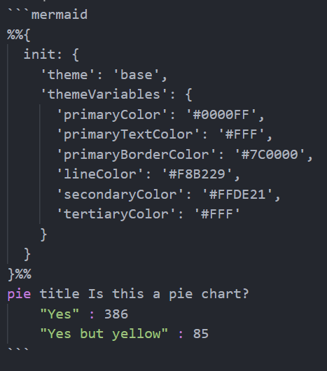
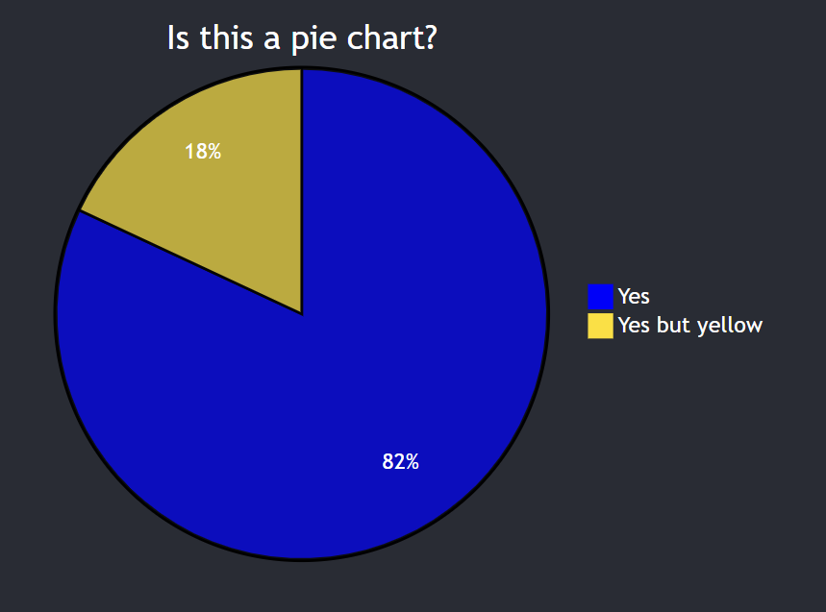
THEMES
Base theme

Slide 39
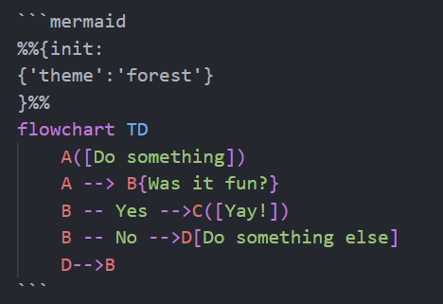
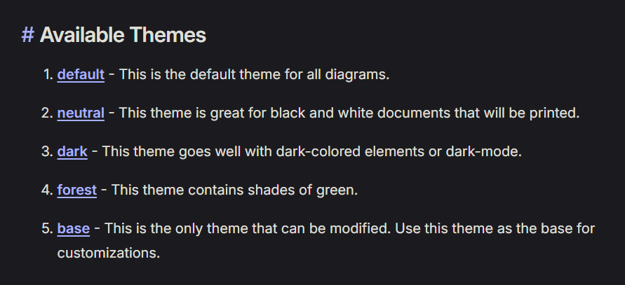
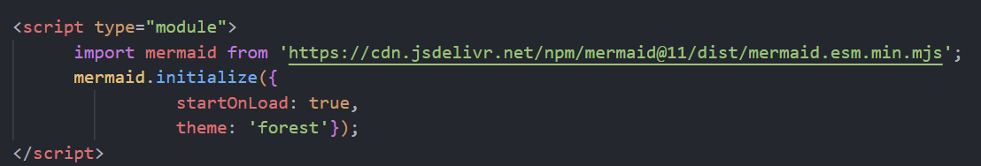
THEMES

Slide 40
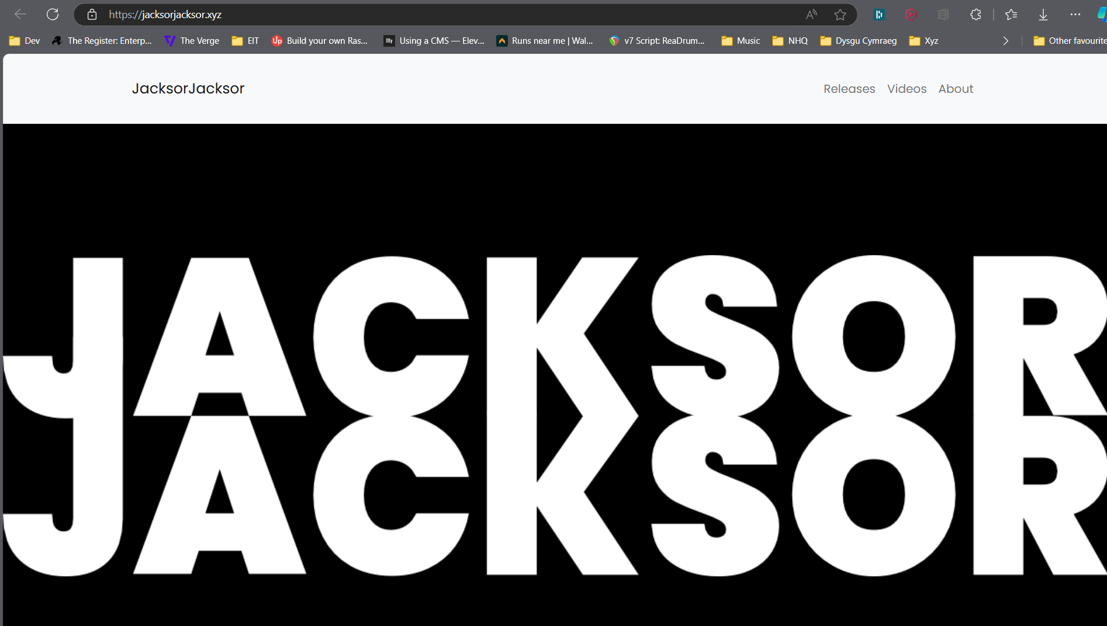
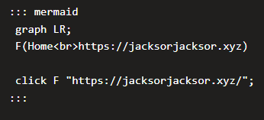
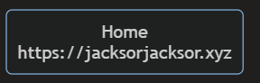
Click Events

Slide 41
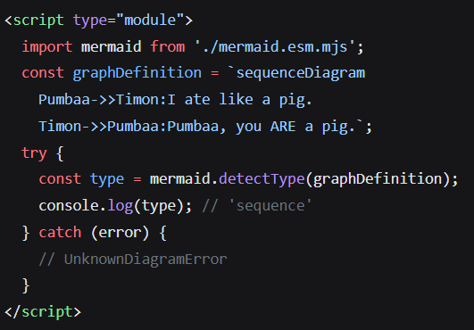
API
Sample: writes type of Mermaid diagram to console

Slide 42
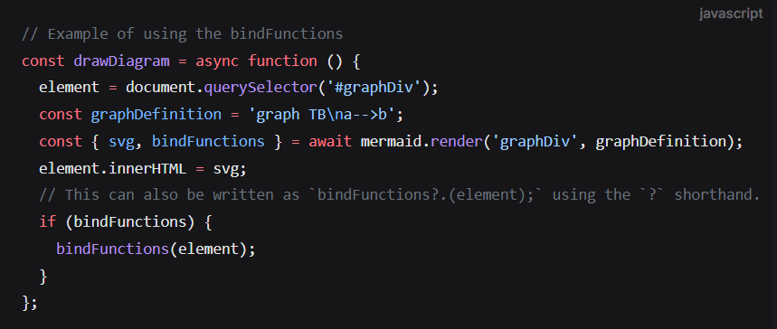
Binding Events
Sample: renders Mermaid diagram THEN allows for tooltip/click event binding

Slide 43
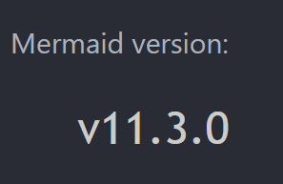
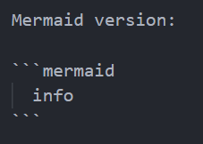
Checking Versions

Slide 44
5. “Where can Mermaid do the things that Mermaid can do?”

Slide 45

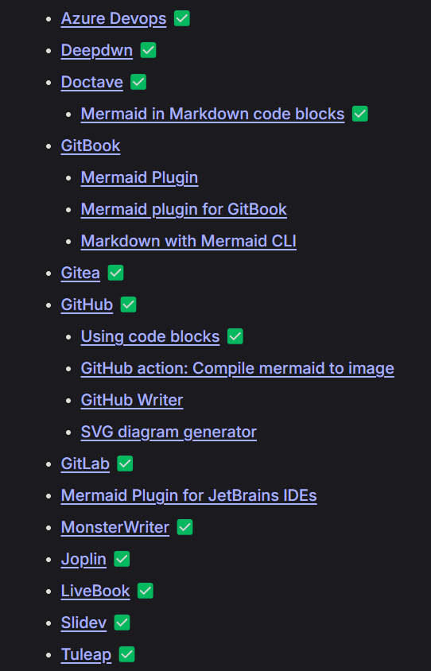
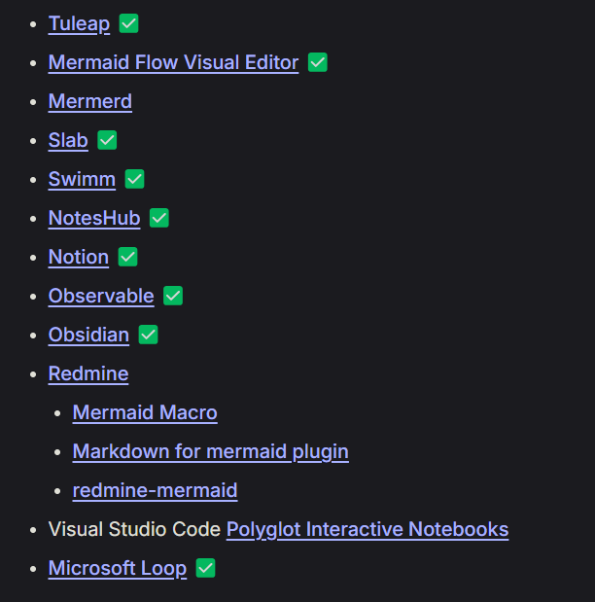
Mermaid JS Integrations
Native support for Mermaid
Notes:
Source control platforms
Notetaking / information management tools

Slide 46

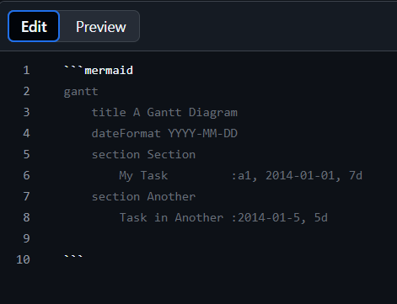


GitHub
Any Markdown file
Available since Feb 2022:
Include diagrams in your Markdown files with Mermaid - The GitHub Blog

Slide 47


GitHub Mermaid rendering Process
Source: GitHub HTML Rendering Pipeline

Slide 48



Azure DevOps
Wiki Entries only

Slide 49


Microsoft Loop

Slide 50




Visual Studio Code
Extension required

Slide 51

Web page

Slide 52




Umbraco CMS (v13)
[Markdown Editor]

Slide 53
Notes:
Import module (by any means necessary) – CDN, NPM package etc.
Create a pre tag with class “mermaid”
Import content, removing <p> tags

Slide 54
Umbraco CMS (v13)
[Markdown Editor]

Slide 55

Mermaid Live Editor
https://mermaid.live

Slide 56
Mermaid Live Editor

Slide 57

AKA a commercialised platform hosting Mermaid tools
All integrations shown so far have been free

Slide 58

Screenshot:
7th November 2024

Slide 59


Slide 60
6. The AI section *drinks*

Slide 61
AI, Mermaid and Code generation
Proposed Workflow:
Use natural language requests to create Mermaid diagrams
Tweak and improve to match what you really want
Use Mermaid to make applications based around diagrams
Tweak and improve to match what you really want
Repeat
Forever

Slide 62


[made in Microsoft Loop]

Slide 64
Copilot’s opinions on the matter:
Clarity and Precision: Mermaid diagrams can provide a clear and precise representation of business requirements, reducing the chances of misunderstandings or misinterpretations.
Enhanced Collaboration: Visual diagrams can facilitate better collaboration among team members, as they provide a common reference point that is easy to understand.
Streamlined Development: By using Copilot to generate code based on well-defined requirements, you can streamline the development process and ensure that the code aligns closely with the business needs.
Improved Documentation: Mermaid diagrams can serve as part of the project documentation, making it easier to maintain and update the project in the future.

Slide 65


Slide 66
7. Reflections

Slide 67
Key SOLUTIONS
Separate file to the work
Markdown in repo with work
Requires upskilling on graphics package
Code-based upskilling
Developers not necessarily comfortable with aesthetic design
Highly-opinionated layout control
Maps can become unwieldy as scope increases
Shared across multiple markdown files
Proprietary file formats
Markdown files only

Slide 68
Mermaid limitations
HIGHLY opinionated – users have zero control over layout
No swimlanes (!!!)
Use swimlanes in flowchart diagram · Issue #2028 · mermaid-js/mermaid
Limited theming
“Another thing to maintain”

Slide 69


Slide 70
In conclusion

Slide 71
Tech Is Hard

Slide 72
Be excellent to each other

Slide 73
Thank you for listening!
Richard Jackson
@jacksorjacksor
All code snippets:
github.com/jacksorjacksor
Umbraco Kent Meetup | 12th November 2024

Slide 74


8. Q&A

